Slide 1
Aspen: Material Balances & Reactions of Custom Compounds
CHBE446, Group 6
Andrew Loveland, Elisa Zeng-Mariotti, Natalya Brown, Chris Duchak

Slide 2
Material Balances with Reactions
Mass in = Mass out
A certain amount of a component that goes into a system will come out
The stoichiometry of the reaction must be considered
Example: Ammonia Production

Slide 3
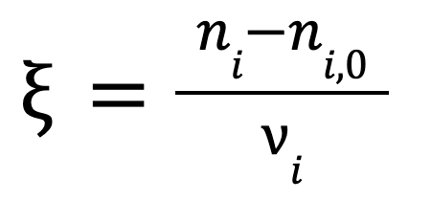
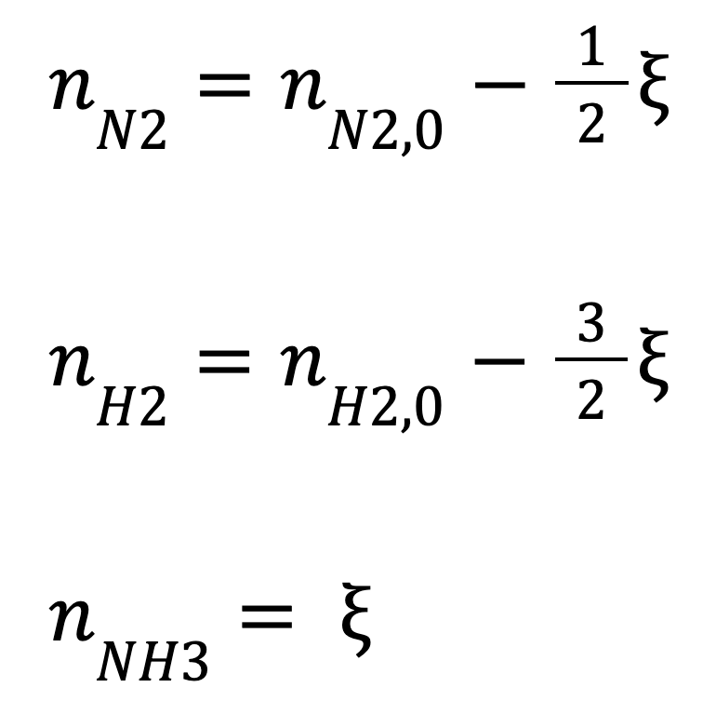
Simplified Ammonia Reaction Material Balance
If you define 2 of the products, you can solve for the amount of reactants needed!

Slide 4
How To Use Aspen to Perform Material Balances
Aspen can be used to calculate needed inlet compositions with known outlet conditions using a design spec
Otherwise, define inlets and Aspen will automatically calculate the outlet compositions

Slide 5
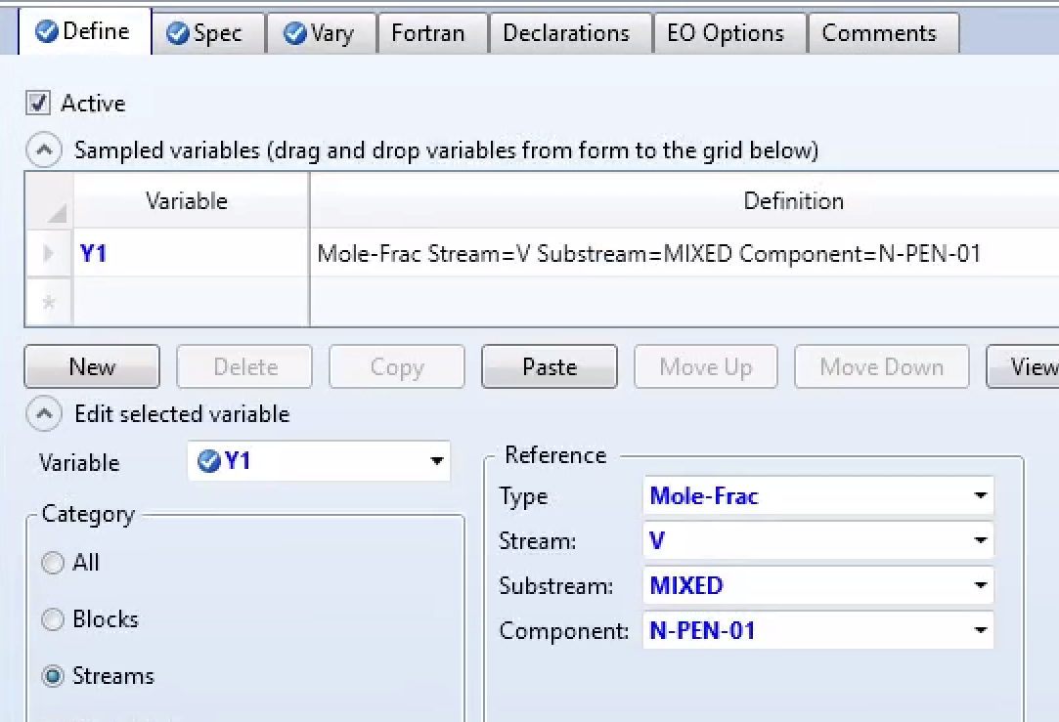
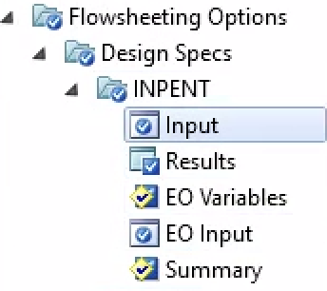
Calculate Inlet Conditions with Desired Outlet Conditions
Example: Flash evaporator with known conditions, known outlet vapor composition, but unknown inlet composition
Goal: Find inlet composition needed to produce desired vapor product
Step 1: Under “Simulation” on Aspen, go to “Flowsheeting Options”, select Design Spec
Step 2: Define outlet variable type

Slide 6
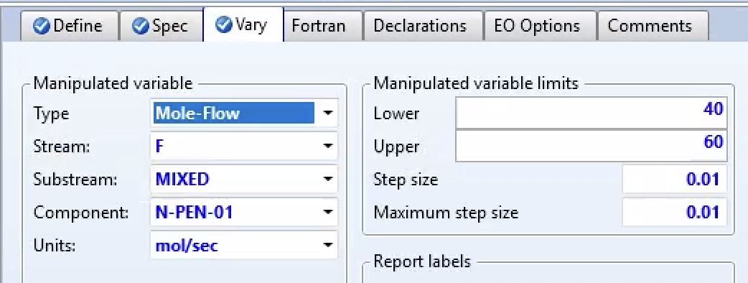
Mass Balances with Design Spec cont.
Step 4: Define the inlet variable to calculate
Step 3: Define the target output value

Slide 7
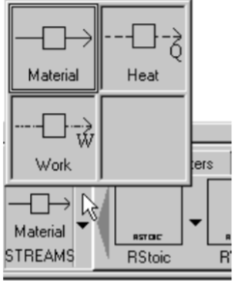
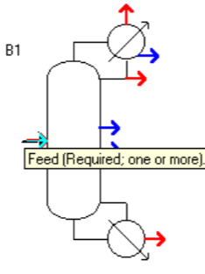
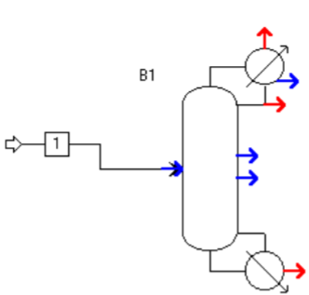
How to Add Material Streams
Step 1: Select Streams tab and if necessary stream type
Step 2: Select where the streams should go in and out of the reactor
Step 3: Click the mouse where you would like to connect the stream and again to place the end
Notes:
Bottom left near blocks 2) All possible highlighted. Red meaning a stream must be connected there for Aspen to run without error 3) Connecting it to an inlet or outlet will cause the other inlets/outlets to disappear as two inlets cannot be connected.

Slide 8
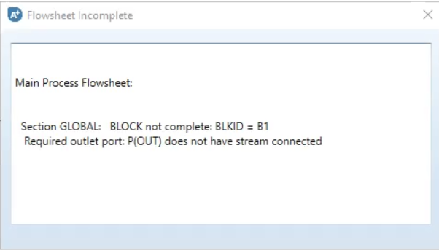
How to Add Material Streams
Step 4: Verify that the flowsheet is complete with no required streams unfilled before moving on
Notes:
4) this can be done by looking in the bottom left hand corner if you see the red flowsheet not complete not everything is connected and specified. This will not say input complete if only the flowsheet is complete as for that you must specify enough of the input or output streams for aspen to be able to calculate the rest but you can click the check status button to see what is still needed to complete the inputs or click on the next button at the top of the screen and completion status window will pop up telling you what aspen requires for you to proceed including if the streams are all connected correctly

Slide 9
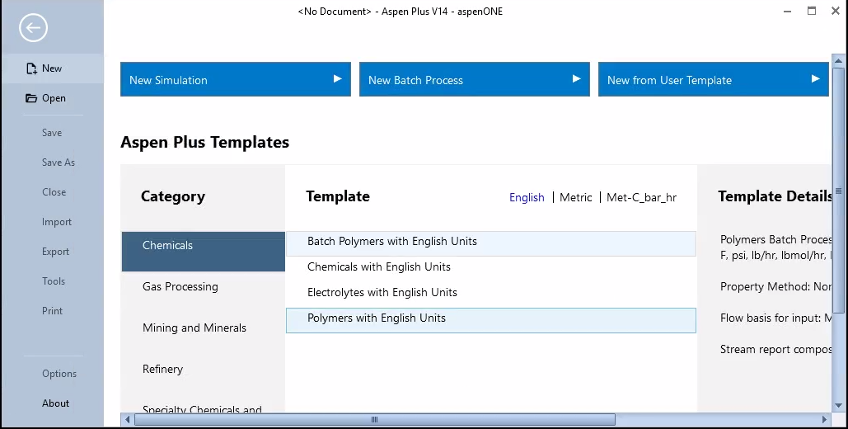
How To Define Custom Compounds in Aspen
Step 1 : Begin new simulation

Slide 10
Step 2: Type the name of your component in the “Component ID” tab and click the “tab” button on your computer to switch over to the “Type” tab. Leave the selected type as “Conventional”
Step 3: Select “User defined” below the Components entry field. Note: It may display a confirmation tab, simply click “Next” to continue

Slide 11
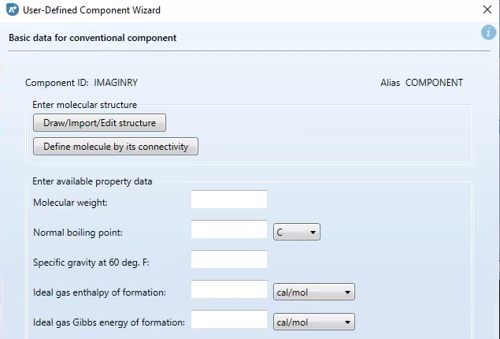
Step 4: Click “ Draw/Import/ Edit Structure”

Slide 12
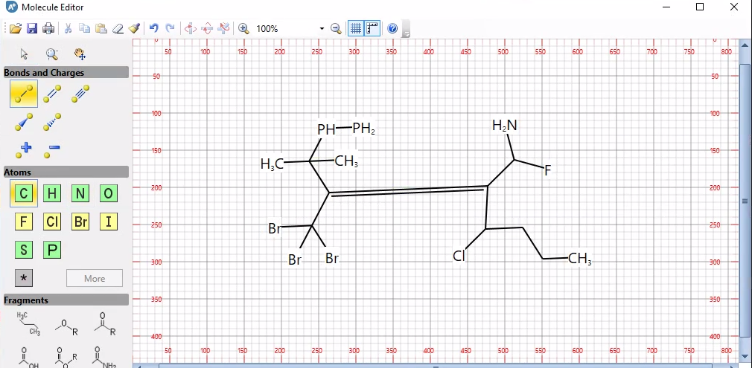
Step 5: Use the tools in the “Molecule Editor” tab to draw the structure of your unique compound. Note: If your compound contains elements that are not Carbon, first draw your structure containing only Carbon molecules then select the alternative element from the “Atoms” tab and click where the Carbon that holds its place is to replace that Carbon element.

Slide 13
Step 6: Click the save icon on the top of of the “Molecule Editor” tab and save the molecule with its desired name as a “.mol” file to your computer.
Step 7: Close the “Molecule Editor” tab

Slide 14
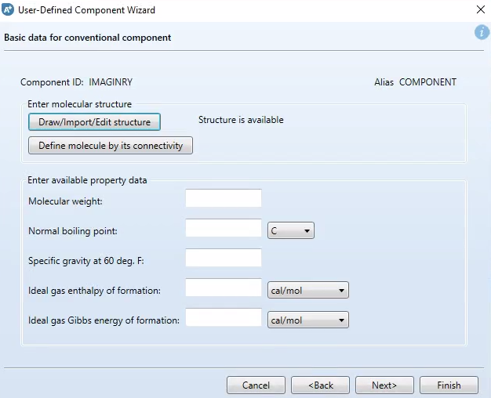
Step 8: Return to the “User Defined Component Wizard” tab which should already be on the screen and click “Next”. Note: Confirm that the tab now says “Structure is available”

Slide 15
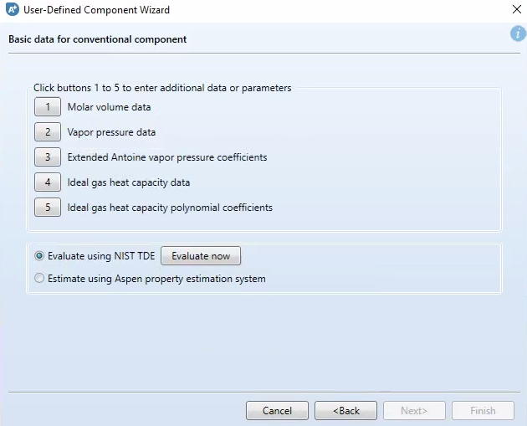
Step 9: Select “Evaluate using NIST TDE” and click “Evaluate now”. Note: It may display a confirmation tab, simply click “OK” to continue

Slide 16
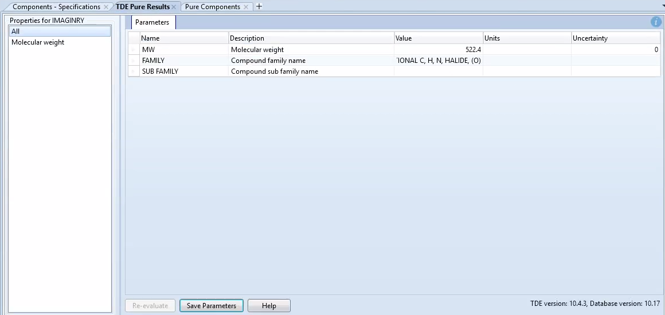
Step 10: ASPEN will display a list of parameters from NIST’s evaluation of your drawn compound under a “TDE Pure Results” tab. Click “Save Parameters” to save the properties of your compound for future use. Note: It will display a “Parameters to be saved” window, leave all parameters checked and click “OK” to continue

Slide 17
Custom Reactions
Define reactions using existing and custom components
Aspen has multiple options for defining kinetics (powerlaw, custom, etc.)
Non-conventional compounds (coal)

Slide 18
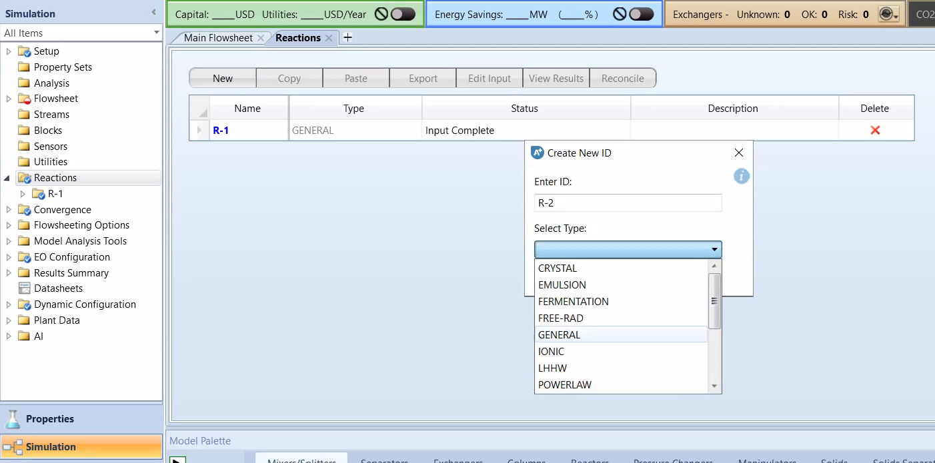
Adding Reactions

Slide 19
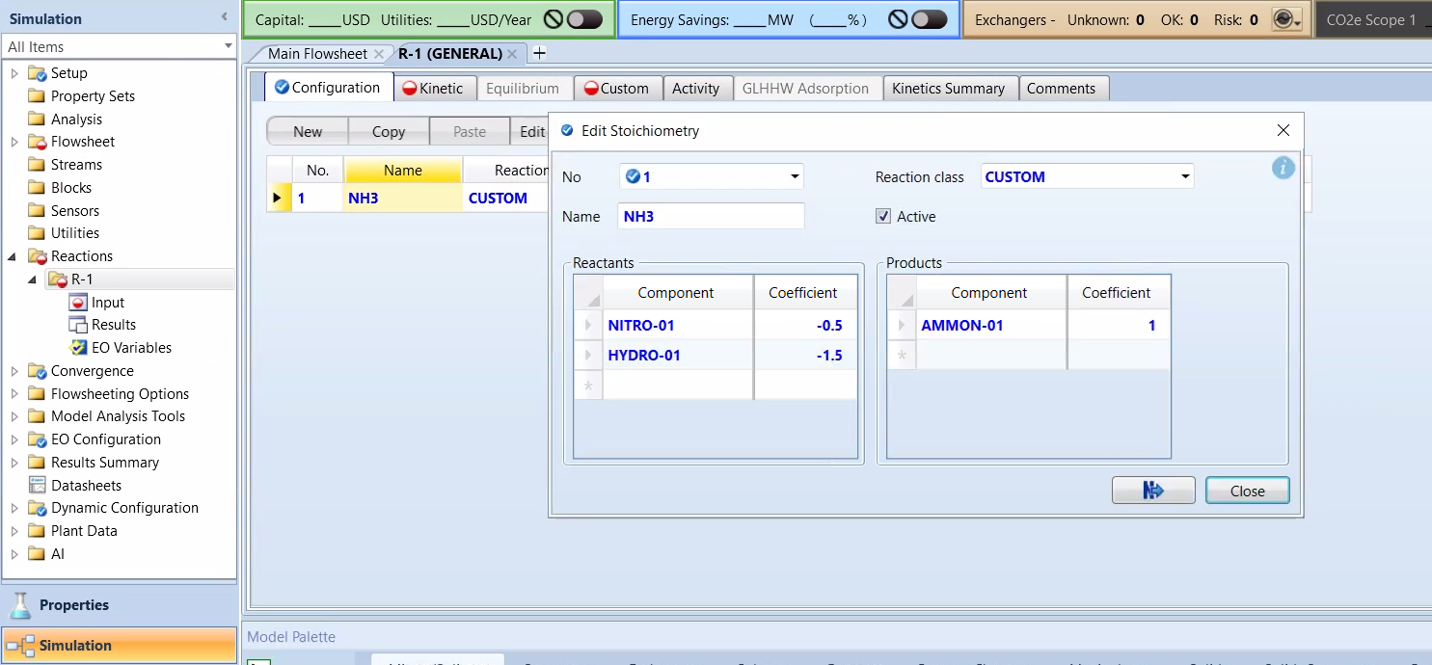
Defining Stoichiometry

Slide 20
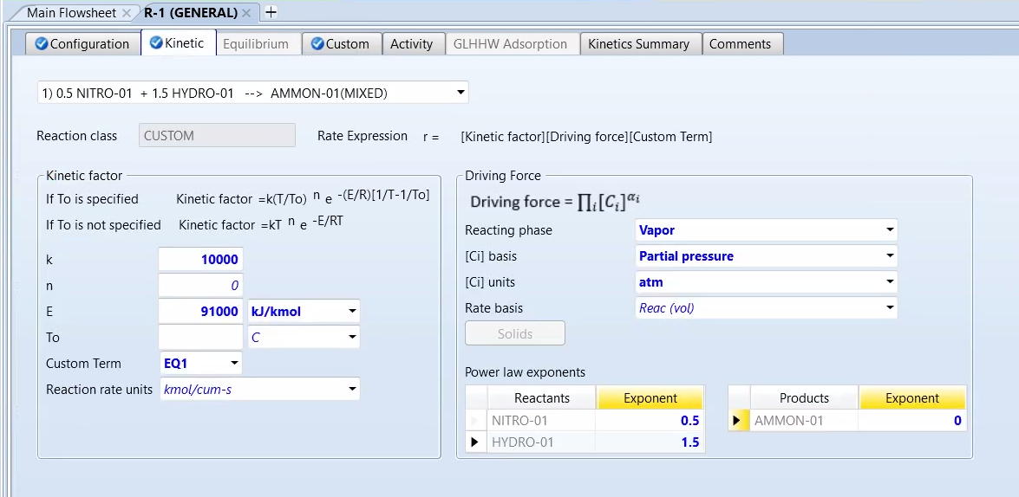
Kinetics

Slide 21
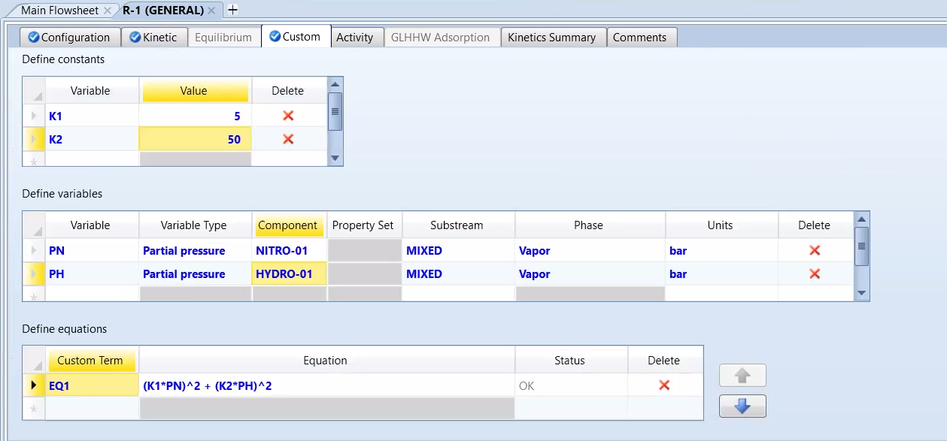
Custom Kinetics

Slide 22
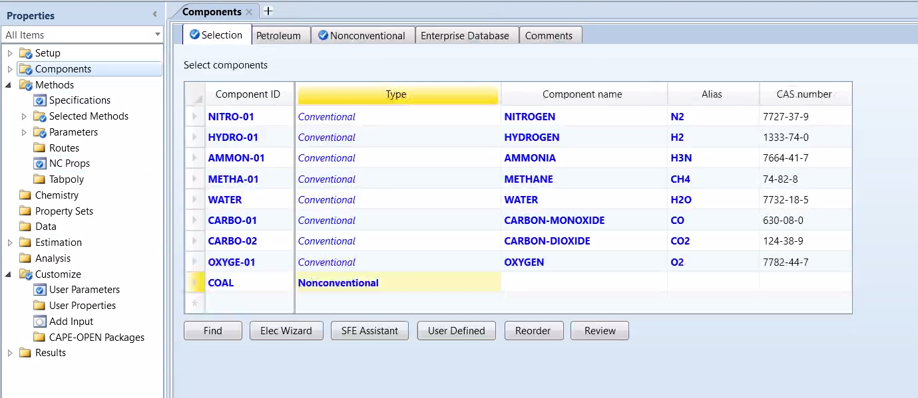
Adding Non Conventional Components

Slide 23
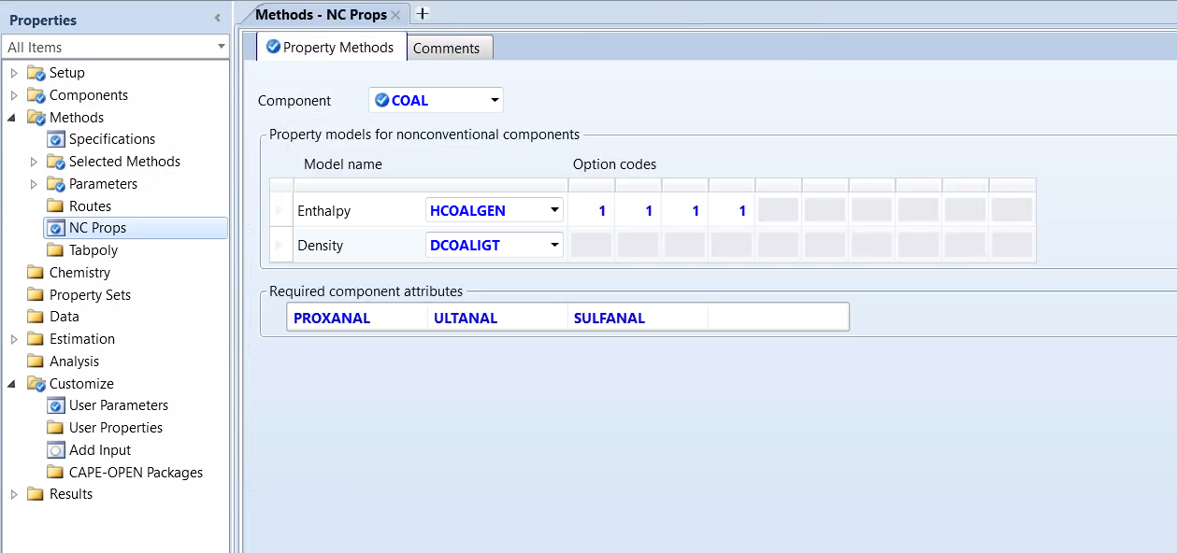
Coal example

Slide 24
Resources
CHBE444 Workshop D part 1
CHBE444 Workshop D part 2
CHBE444 Ammonia Cold Shot Reactor Design
CHBE444 Final Project Unit 2
Aspen PLus V10 User Guide 1
Aspen Technology, Inc. (2012, October 26). Create your own molecules with Aspen Plus® v8.0. Create Your Own Molecules with Aspen Plus® V8.0. https://lms.nchu.edu.tw/sysdata/doc/7/781150a761299e66/pdf.pdf
Biomass Gasification Modelling with Aspen Plus. https://www.youtube.com/watch?v=qYZLCIDaoE0&ab_channel=HotSpot
Aspen Plus - Nonconventional Component Coal (Proximate, Ultimate, Sulfur Analysis). https://www.youtube.com/watch?v=zid5ngN1Y-I&ab_channel=MohamadReziAbdulHamid

